Slide 1
Implementation of RDMA over Ethernet
Student: Zhuangdi Zhu
Mentors: Kun Zhang Alex Liu

Slide 2
Summary
Background
Testing Environment
Methodology
Work I Have Done
Challenges
Further Work & Questions

Slide 3
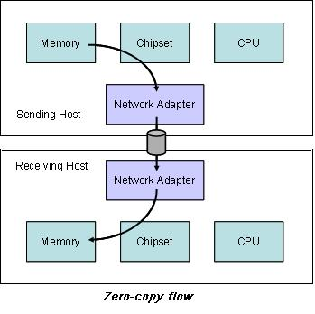
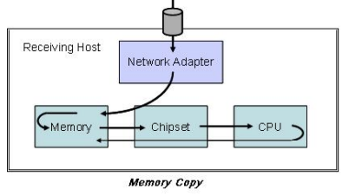
Background: Remote Direct Memory Access(RDMA)
RDMA provides high-throughput, low-latency networking:
⬥ Reduce consumption of CPU cycles
⬥ Reduce communication latency
Notes:
RDMA is the ability of accessing( i.e. reading from or writing to) on a remote machine without interrupting the processing of CPU(s) on that system.

Slide 4
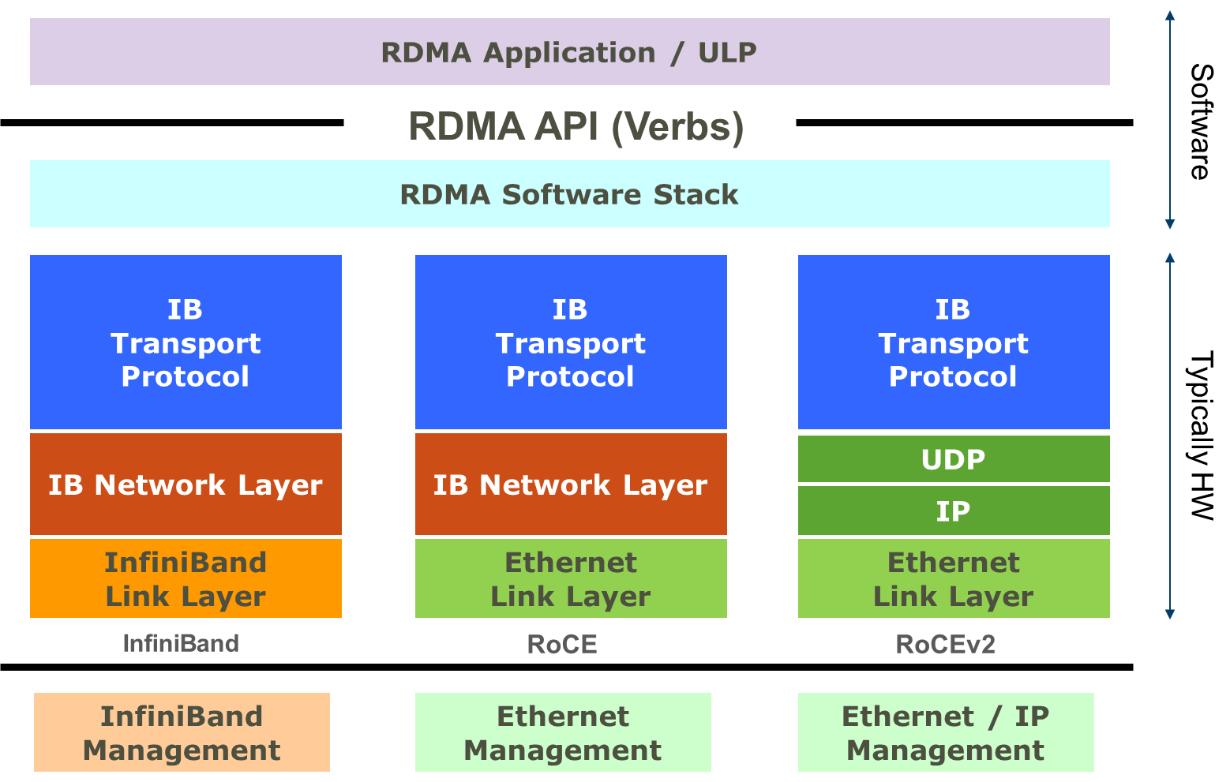
Background: Remote Direct Memory Access(RDMA)
Today, there are several network protocols which support RDMA:
⬥ InfiniBand (IB)
⬥ RDMA Over Converged Ethernet (RoCE)
⬥ Internet Wide Area RDMA Protocol (iWARP)

Slide 5
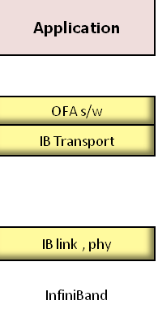
Background: InfiniBand (IB)
a new generation network protocol which supports RDMA natively from the beginning. it requires NICs and switches which supports this technology.
⬥ High throughput
⬥ Low latency
⬥ Quality of service
⬥ Fail over
⬥ Scalability
⬥ Reliable transport

Slide 6
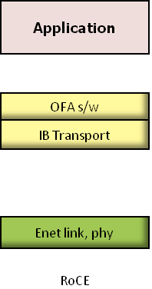
Background:RDMA over Converged Ethernet (RoCE)
a network protocol which allows performing RDMA over Ethernet network.
Its lower network headers are Ethernet headers and its upper network headers (including the data) are InfiniBand headers. This allows using RDMA over standard Ethernet infrastructure (switches). Only the NICs should be special and support RoCE.

Slide 7
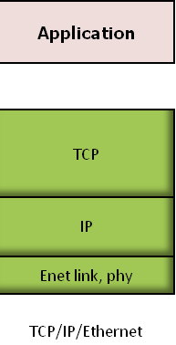
Background: Internet Wide Area RDMA Protocol (iWARP)
a network protocol which allows performing RDMA over TCP.
There are features that exist in IB and RoCE and aren't supported in iWARP. This allows using RDMA over standard Ethernet infrastructure (switches).
Only the NICs should be special and support iWARP (if CPU offloads are used) otherwise, all iWARP stacks can be implemented in SW and loosing most of the RDMA performance advantages

Slide 8
Experimentation paths
(1). Two Linux (Ubuntu) hosts: single data transfer using TCP and four data transfers using TCP. Each transfer is 1 GB file.
(2). Two Linux (Ubuntu) hosts: single data transfer using RDMA and four data transfers using RDMA. Each transfer is 1GB file.
(3). Two Linux hosts (Ubuntu) single guest VM on each: data transfer using TCP and four data transfers using TCP . Each transfer is 1GB file.
(4). Two Linux hosts (Ubuntu) single guest VM on each: data transfer using RDMA and four data transfers using RDMA. Each transfer is 1GB file.

Slide 9
Experimentation paths
(5). Two Linux hosts (Ubuntu) single LXC on each: data transfer using TCP and four data transfers using TCP . Each transfer is 1GB file.
(6). Two Linux hosts (Ubuntu) single LXC on each: data transfer using RDMA and four data transfers using RDMA. Each transfer is 1GB file.
(7). Two Linux hosts (Ubuntu) four guest VMs on each: single data transfer using TCP from single guest on one host to a single guest on other host.
(8). Two Linux hosts (Ubuntu) four guest VMs on each: single data transfer using RDMA from single guest on one host to a single guest on other host.
(9). Two Linux hosts (Ubuntu) four LXC containers/dockers on each: single data transfer using TCP from single LXC/Docker on one host to a single LXC/Docker on other host.
(10). Two Linux hosts (Ubuntu) four LXC containers/dockers on each: single data transfer using RDMA from single LXC/Docker on one host to a single LXC/Docker on other host.

Slide 10



Testing Environment
Hardware:
MacBook severs
Operating System:
CentOS 6.5/6.6
Software/Drivers:
Open Fabrics Alliance OFED(3.12/3.5)

Slide 11
Methodology
Set up a pair of nodes for each technology:
RDMA(RoCE/ iWARP/ IfiniBand) and TCP.
Install, configure & run minimal services on test nodes to maximize machine performance.
Directly connect nodes to maximize network performance.
Acquire latency benchmarks
Acquire bandwidth benchmarks
Install single guest VM on each node, repeat the above steps.
Install four guest VMs on each node, repeat the above steps.

Slide 12
Work I have done
Reading list:
✓ Accelerating Spark with RDMA for Big Data Processing: Early Experiences
✓ IBM Zurich – RDMA
✓ Hadoop RDMA
✓ Accelerating Big Data with RDMA solutions
✓ Features/RDMALiveMigration - QEMU
✓ RDMA Consortium

Slide 13
Work I have done
Reading list
RFC5532 - Network File System (NFS) Remote Direct Memory Access (RDMA) Problem Statement
RFC5041 - Direct Data Placement over Reliable Transports
✓ RFC5042 - Direct Data Placement Protocol (DDP) / Remote Direct Memory Access Protocol (RDMAP) Security
✓ RFC5040 - A Remote Direct Memory Access Protocol Specification
RFC7146 - Securing Block Storage Protocols over IP: RFC 3723 Requirements Update for IPsec v3

Slide 14
Work I have done
Other references
Z-Copy Education and Sample Code for RDMA Programminghttp://zcopy.wordpress.com/2010/10/08/quick-concepts-part-1-%E2%80%93-introduction-to-rdma/
Introduction to Remote Direct Memory Access (RDMA)http://www.rdmamojo.com/2014/03/31/remote-direct-memory-access-rdma
3. Working with RDMA in RedHat/CentOS 6.*
http://www.rdmamojo.com/2014/09/20/working-rdma-redhatcentos-6/
RDMA Performance in Virtual Machines using QDR InfiniBand on Vmware http://www.mellanox.com/related-docs/whitepapers/RDMA_Performance_in_Virtual_Machines_using_QDR_InfiniBand_on_VMware_vSphere5.pdf
Access to InfiniBand* from Linux*
https://software.intel.com/en-us/articles/access-to-infiniband-from-linux/

Slide 15
Work I have done
Experimentations:
tried to install Open Fabrics Alliance OFED(3.12 and 3.5) but it seems in-compatible with Linux version(CentOS 6.6 and 6.5).

Slide 16
Further work & Questions
Install SoftRoCE in Virtualbox

